Slide 1


Evaluating Classification Models
Wake Forest
School of Business
_______
BAN 7040

Slide 2
Confusion Matrix
 | Actual: Yes | Actual: No
Predicted: Yes | 50 | 5
Predicted: No | 10 | 35
 | 60 | 40 | 100

Slide 3
Accuracy / Misclassification Rate
 | Actual: Yes | Actual: No
Predicted: Yes | 50 | 5
Predicted: No | 10 | 35
 | 60 | 40 | 100
Accuracy = (50 + 35) / 100 = 85%
Misclassification Rate = (10 + 5) / 100 = 15%

Slide 4
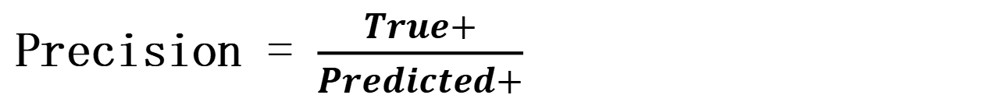
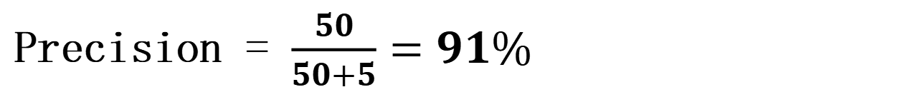
Precision What proportion of positive identifications was actually correct?
 | Actual: Yes (+) | Actual: No (-)
Predicted: Yes (+) | 50 | 5
Predicted: No (-) | 10 | 35
 | 60 | 40 | 100
Precision = $\frac{True+}{Predicted+}$
Precision = $\frac{50}{50+5}=91\%$

Slide 5


Recall What proportion of actual positives was identified correctly?
 | Actual: Yes (+) | Actual: No (-)
Predicted: Yes (+) | 50 | 5
Predicted: No (-) | 10 | 35
 | 60 | 40 | 100
Recall = $\frac{True+}{Actual+}$
Recall = $\frac{50}{60}=83\%$

Slide 6
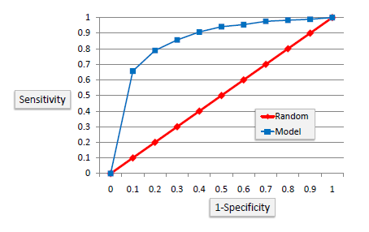
ROC Curve
Area Under the ROC curve (AUC, c-statistic, ROC Index)
- Values closer to 1 indicate the model is a better classifier
- Values close to 0.5 indicate the model can’t distinguish between the groups
Notes:
true+/false+

